Slide 1
Working with families experiencing substance use
Sara Jackson, LMSW, LMAC
Heartland RADAC
5500 Buena Vista
Roeland Park, KS 66205

Slide 2
Addiction: Myth Vs. Fact

Slide 3
Myth: "Addiction only happens to certain kinds of people”.
______________________________
Fact: Addiction can happen to anyone, no matter their race, upbringing, personality type, or grade point average.

Slide 4
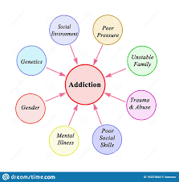
Truth
There are genetic, social, and psychological risk factors that can put some people at greater risk—but addiction has nothing to do with a person’s character.

Slide 5
Myth: "People with addiction need tough love. Helping them just enables drug use”.
___________________________
Fact: Showing love and support are never bad things.

Slide 6
Truth
Boundaries and self-care are important, but lifesaving interventions should never be denied out of an impulse to teach someone a lesson. Not only is it cruel, but it’s ineffective. Addiction is an illness.

Slide 7
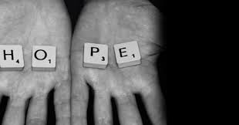
Myth: "People with addiction are hopeless.“
___________________________________
Fact: People can and do recover from addiction every single day.

Slide 8
Truth
In fact, millions of Americans are thriving in recovery right now. We just don’t hear their stories as often. Once treatment begins, someone with a substance use disorder can move on to manage their illness, just as they would any other chronic illness. With the right treatment, recovery is possible for everyone.

Slide 9
Why do some people get addicted but others don’t?
Risk Factors for Addiction:
Substance use alone doesn’t cause addiction. Addiction is a complex illness that arises in a person based on their unique circumstances.
Environment: Exposure to traumatic experiences has been shown to increase a person's risk of developing a substance use disorder. These experiences could happen at school, at home, or out in the community
Biology: Scientific research has shown that 40–60% of the likelihood that a person will develop addiction comes from genetics. This includes both a family history of the illness as well as epigenetics, which are "the effects environmental factors have on a person's gene expression." Plus, if you have a behavioral health disorder like depression or anxiety, your risk of addiction also increases.

Slide 10
Why do some people get addicted but other’s don’t?
Using drugs for the first time at a young age can also increase addiction risk. Also, snorting or injecting drugs can increase the risk of becoming addicted to those drugs, due to the extreme way the drug is delivered into the body (and the quickness with which the feeling fades).

Slide 11
Why do some people get addicted but other’s don’t?
Ultimately, the answer lies in a person’s unique brain chemistry and lived experiences. Most people who develop addiction are looking to heal or soothe themselves in some way.

Slide 12
Addiction in America

Slide 13
The addiction crisis is deadlier than ever before.
Overdoses are the #1 cause of accidental death in our country. 81,230 overdose deaths occurred in the United States from June 2019 through May 2020. That’s the highest number of overdose deaths ever recorded in a single year. Synthetic opioids like fentanyl are the biggest drivers but the use of stimulants like cocaine and methamphetamines is also on the rise. From 2013 to 2018, the rate of cocaine overdose deaths tripled.
During the COVID-19 pandemic, this tragedy has gotten worse. In some communities, overdose-related emergency calls are up as much as 40% and 42 states reported increases in overdose deaths during the pandemic.
And it’s not just overdoses taking lives: In 2018, more than 175,000 deaths in the U.S. were related to alcohol and other drugs. That makes substance use the third largest cause of death in the nation.

Slide 14
Addiction, Mental Health, and Trauma
As researchers discover more about how addiction affects the brain, they’re also starting to understand how and why substance use disorders and mental health conditions often go hand in hand.

Slide 15
What is a co-occurring disorder?
A co-occurring disorder, also called comorbidity or dual diagnosis, is a medical issue that occurs either simultaneously, or successively after another disease. These conditions may be mental or physical or a combination of the two. Often, the existence of co-occurring conditions makes each disease worse than if it as it experienced individually.
The co-occurrence of substance use and mental health disorders is particularly common because similar areas of the brain are involved with both.

Slide 16
These behavioral health disorders commonly co-occur with addiction:
Anxiety and mood disorders
Schizophrenia
Bipolar disorder
Major depressive disorder
Conduct disorders
Post-traumatic stress disorder (PTSD)
Attention deficit hyperactivity disorder (ADHD)

Slide 17
How many people with addiction have co-occurring mental health disorders?
In 2014, SAMHSA found that approximately 7.9 million people in the United States experienced addiction and a mental health disorder simultaneously. That’s nearly 40% of the total population who experienced addiction in that year.
Statistics from The National Institute on Drug Abuse (NIDA) on co-occurring disorders show that patients with mood-related mental health disorders or anxiety are twice as likely to also suffer from addiction. Similarly, patients with addiction are roughly twice as likely to be diagnosed with those types of mental health disorders.

Slide 18
Trauma increases addiction risk
Most people who develop an addiction are looking for healing in some way or another. Substances, as harmful as they may be, may seem to provide that—especially for people who’ve endured trauma.

Slide 19
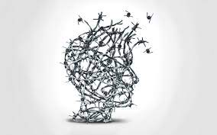
Trauma Increases Addiction Risk
The Substance Abuse and Mental Health Services Association (SAMHSA) defines trauma as specific events or experiences that create “long-lasting adverse effects” for an individual. Trauma could result from physical, emotional, or sexual abuse. It could result from enduring a natural disaster or a war. No matter the root cause of the trauma, it increases a person’s risk of developing a substance use disorder.

Slide 20
Childhood Trauma
New research is showing the influence of Adverse Childhood Experiences, or ACEs, on lifelong health.
Most common ACEs:
Witnessing violence
Experiencing abuse/neglect
Being frequently humiliated or intimidated by adults
Not having enough to eat
Persistent loneliness
Sexual abuse

Slide 21
ACEs are more common than you might think: The CDC reports, “61% of adults surveyed across 25 states reported that they had experienced at least one type of ACE, and nearly 1 in 6 reported they had experienced four or more types of ACEs.”
ACEs don’t just put a person at risk of diseases of the brain, like behavioral health or substance use disorders. ACEs also put people at greater risk of chronic health problems in the body, like cancer, diabetes, and heart disease.

Slide 22
Trauma: What was traumatic for you, big or little is significant
Big T: result from identifiable events that almost anyone would find disturbing
Little t: typically subtler and chronic and much more common than Big T Traumas
War, invasion, attach
Natural disasters
Rape
Sexual or physical abuse
Acts of racism
Witnessing violence
Chronic neglect, especially among children and the elderly
Unexpected death of someone close
Failing at something important to you
Losses (loss of a prized possession, a hoped-for promotion)
High stress at work or school
Rejection
Being yelled at
Being ignored, disrespected, or discounted
Betrayal
Infidelity of your partner or parent

Slide 23
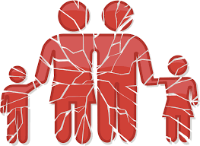
How does the family fit in?

Slide 24
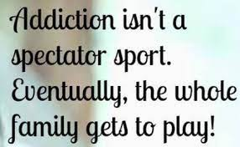

Slide 25
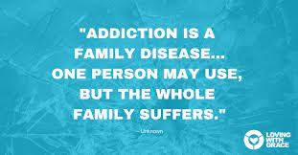

Slide 26
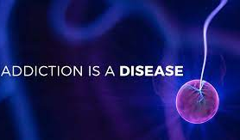
Disease of addiction
Negative consequences add up when active addiction is present
Social, relational, emotional, spiritual and physical areas are affected in the addicts life and the family
Drama and trauma become commonplace to everyone involved

Slide 27
Addition is a process
Family (and social circle) face physical, spiritual and emotional pain
Family members experience loneliness, hopelessness, isolation, anger, guild and grief
Addiction is intense and long:
Addiction does not develop overnight; addiction is a process

Slide 28
Addiction is a family disease
When the addict comes into treatment, the family system enters treatment – directly or indirectly
Family system becomes dysfunctional over time due to the presence of addiction
The change is usually gradual enough the other members learn to adapt to their roles without awareness of change taking place
The adaptation perpetuates the disease

Slide 29
Enabling
Spouses, children, extended friends and family “help” when troubles arise from the addiction
These efforts, intended to help, often protect the addict from negative consequences of his/her disease
This protection arises out of a combination of love and self-interest and is called enabling because it allows the active addiction to continue

Slide 30
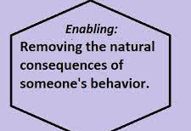
Enabling
Enabling typically has a negative connotation
Enabling takes place in the context of ignorance related to the disease
Enabling is genuine caring about the addict and the integrity of the family, and the need to cope with a threatening and stressful situation

Slide 31
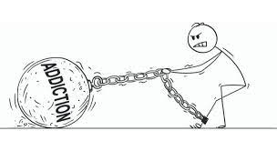
Can I “fix” the alcoholic/addict in my life?
Over time, families and friends try almost anything to help the addict
Energy is invested in trying to control or “fix” the alcoholic and/or addict
Addiction cannot be cured, or fixed by these attempts
A sense of learned helplessness develops

Slide 32
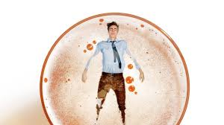
Failed attempts
Failed attempts to make the situation better can be frustrating and confusing
Anger and resentments continue to build
Everyone affected by addiction fabricates lies to protect themselves, but which in the end actually perpetuates the disease

Slide 33
Effects on others
Neighbors, friends, and coworkers also experience the effects of substance abuse because a person who abuses substances often is unreliable.
Friends may be asked to help financially or in other ways.
Coworkers may be forced to compensate for decreased productivity or carry a disproportionate share of the workload.
As a consequence, they may resent the person abusing substances.

Slide 34
Effects on others
People who abuse substances are likely to find themselves increasingly isolated from their families. Often they prefer associating with others who abuse substances or participate in some other form of antisocial activity. These associates support and reinforce each other’s behavior.

Slide 35
Patterns of interaction found in a family where one or more of the parents or children are likely to be abusing alcohol or illicit drugs:
Negativism. Any communication that occurs among family members is negative, taking the form of complaints, criticism, and other expressions of displeasure. The overall mood of the household is decidedly downbeat, and positive behavior is ignored. In such families, the only way to get attention or enliven the situation is to create a crisis. This negativity may serve to reinforce the substance abuse.
Parental denial. Despite obvious warning signs, the parental stance is: (1) “What drug/alcohol problem? We don’t see any drug problem!” or (2) after authorities intervene: “You are wrong! My child does not have a drug problem!”
Parental inconsistency. Rule setting is erratic, enforcement is inconsistent, and family structure is inadequate. Children are confused because they cannot figure out the boundaries of right and wrong. As a result, they may behave badly in the hope of getting their parents to set clearly defined boundaries. Without known limits, children cannot predict parental responses and adjust their behavior accordingly. These inconsistencies tend to be present regardless of whether the person abusing substances is a parent or child and they create a sense of confusion—a key factor—in the children.

Slide 36
Patterns of interaction continued:
Miscarried expression of anger. Children or parents who resent their emotionally deprived home and are afraid to express their outrage use drug abuse as one way to manage their repressed anger.
Self‐medication. Either a parent or child will use drugs or alcohol to cope with intolerable thoughts or feelings, such as severe anxiety or depression.
Unrealistic parental expectations. If parental expectations are unrealistic, children can excuse themselves from all future expectations by saying, in essence, “You can’t expect anything of me—I’m just a pothead/speed freak/junkie.” Alternatively, they may work obsessively to overachieve, all the while feeling that no matter what they do it is never good enough, or they may joke and clown to deflect the pain or may withdraw to side‐step the pain. If expectations are too low, and children are told throughout youth that they will certainly fail, they tend to conform their behavior to their parents’ predictions, unless meaningful adults intervene with healthy, positive, and supportive messages.

Slide 38
Role #1: The Addicted
People struggling with substance abuse live in a constant state of chaos. Alcohol becomes the primary way to cope with problems and difficult feelings, and in turn, he or she will stop at nothing to supply this need. As a result, they burn bridges, lie, and manipulate those around them. They isolate and angrily blame others for their problems. It comes as no surprise that their actions create negative effects for the entire family; they can’t seem to focus on anything other than the next drink.

Slide 39
Role #2: The Enabler
Deny, deny, deny – this is an enabler’s M.O. The goal of this role is to smooth things over within the family. In order to “protect” the family, enablers convince themselves that alcohol isn’t a problem and, in order to make light of a serious situation, they make excuses for their loved one’s behavior. While the enabler is most often a spouse, this role can also be taken on by a child.

Slide 40
Role #3: The Hero
The family hero is your typical Type A personality: a hard-working, overachieving perfectionist. Through his or her own achievements, the hero tries to bring the family together and create a sense of normalcy. This role is usually taken on by the eldest child, as they seek to give hope to the rest of the family. Unfortunately, a driving need to “do everything right” tends to put an extreme amount of pressure on the hero, leaving them highly anxious and susceptible to stress-related illnesses later in life.

Slide 41
Role #4: The Scapegoat
The scapegoat is just what you would expect: the one person who gets blamed for the whole family’s problems. This role tends to be taken on by the second oldest child; he or she offers the family a sense of purpose by providing someone else to blame. They voice the family’s collective anger, while shielding the addicted parent from a lot of blame and resentment. When scapegoats get older, males tend to act out in violence, while females often run away or participate in promiscuous sex.

Slide 42
Role #5: The Mascot
Think of the mascot as the class clown, always trying to deflect the stress of the situation by supplying humor. This role is usually taken on by the youngest child; they’re fragile, vulnerable, and desperate for the approval of others. Providing comic relief is also the mascot’s defense against feeling pain and fear himself. Mascots often grow up to self-medicate with alcohol, perpetuating the cycle of addiction.

Slide 43
Role #6: The Lost Child
The Lost Child is the invisible child. They try to escape the family situation by making themselves very small and quiet. They staya out of the way of problems and spends a lot of time alone. ... The Lost Child seeks the privacy of his or her own company to be away from the family chaos.

Slide 44
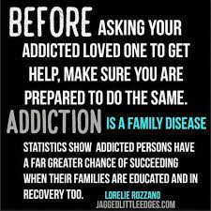

Slide 45
Genogram
A genogram (pronounced: jen-uh-gram) is a graphic representation of a family tree that displays detailed data on relationships among individuals. It goes beyond a traditional family tree by allowing the user to analyze hereditary patterns and psychological factors that punctuate relationships.

Slide 46
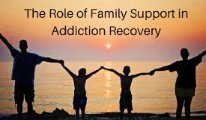
Role of family environment
Post-treatment family and social environments play significant roles in the long-term recovery process
Recovery can destabilize intimate and family relationships that have survived the wounds inflicted by addiction
Families can benefit from extended post-treatment support

Slide 47
Transfer of Learning
The challenge, following treatment, is the transfer of knowledge from the “treatment environment” to the natural environment of the client/family and the acquiring of new skills
Factors in the environment may tip the scales toward recovery or re-addiction as much as the individual factors do

Slide 48
Role of Family Environment in Relapse/Recovery
Family environment exerts a great influence as a source of support or sabotage of addiction recovery
Family members can play a significant role in prompting a person with addiction to seek treatment
Family participation in treatment and family support of recovery efforts exert significant influence on long-term recovery outcomes for adults and adolescents

Slide 49
Role of Family Environment in Relapse/Recovery
Individuals that suffer from addiction are at higher risk level for relapse if their spouses or other family members are high in emotional expression (high levels of criticism, hostility, and emotional enmeshment) and have more drinking days in the year following treatment than clients whose spouses and family members are more encouraging and less controlling – Journal of Consulting and Clinical Psychology

Slide 50
Role of Family Environment in Recovery/Relapse
Frequent substance use within a client’s living environment can serve to sabotage recovery efforts

Slide 51
Family Recovery
Family structure, roles, relationships, rules and rituals are dramatically altered through the process of addiction and must be abandoned and reformed in recovery.
This stressful family readjustment process has been depicted as the “trauma of recovery”
The chaotic family environment of the addiction years continues into the early years of recovery
Early recovery can be much worse than the drinking as there are often varied patterns of dysfunction and resilience

Slide 52
Tips from the professional point of view
Consider the “family” from the client’s point of view—that is, who would the client describe as a family member and who is a “significant other” for the client.
•Assess the “family”—members’ effectiveness of communications, supportiveness or negativity, parenting skills, conflict management, and understanding of addictive disease.
•Don’t give up, and try, try again—many families or family members at first reject any participation in the treatment process. But, after a period of separation from the client who is abusing substances, family members often become willing to at least attend an initial session with the counselor.

Slide 54
External Links:
Links:
Alanon/Alateen:https://al-anon.org/al-anon-meetings/electronic-meetings/
Naranon:https://www.nar-anon.org/find-a-meeting
Heartland RADAC: https://www.hradac.com/

